Slide 1

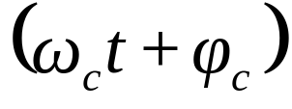
Angle Modulation – Frequency Modulation
Consider again the general carrier
represents the angle of the carrier.
There are two ways of varying the angle of the carrier.
By varying the frequency, ω_{c} – Frequency Modulation.
By varying the phase, φ_{c} – Phase Modulation
1

Slide 2



Frequency Modulation
In FM, the message signal m(t) controls the frequency f_{c} of the carrier. Consider the
carrier
then for FM we may write:
FM signal
,where the frequency deviation
will depend on m(t).
Given that the carrier frequency will change we may write for an instantaneous
carrier signal
where φ_{i} is the instantaneous angle =
and f_{i} is the instantaneous
frequency.
2

Slide 3
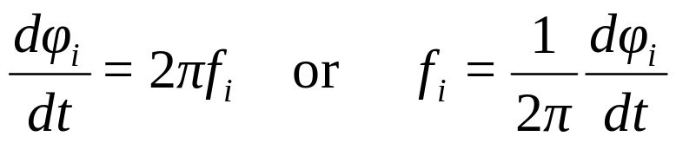

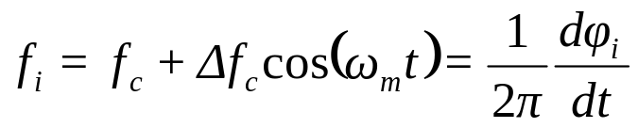
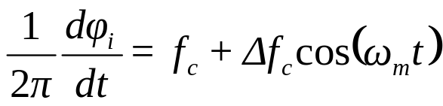
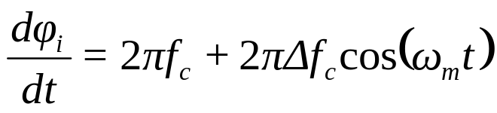
Frequency Modulation
Since
then
i.e. frequency is proportional to the rate of change of angle.
If f_{c} is the unmodulated carrier and f_{m} is the modulating frequency, then we may
deduce that
Δf_{c} is the peak deviation of the carrier.
Hence, we have
,i.e.
3

Slide 4
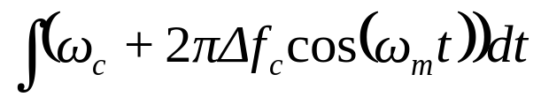
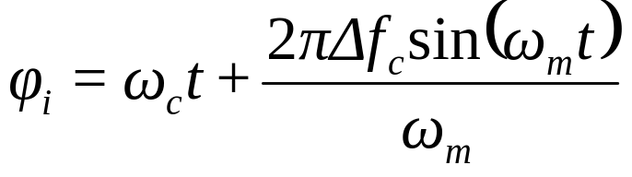
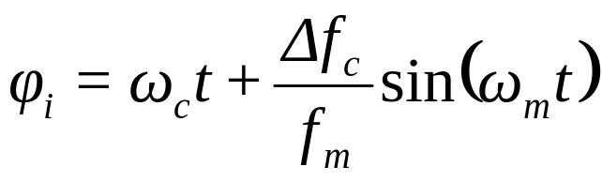
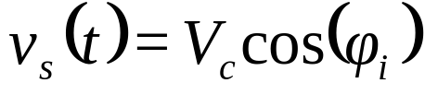
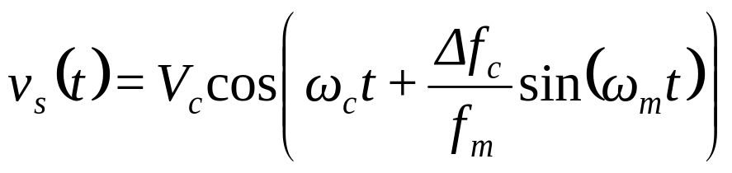
Frequency Modulation
After integration i.e.
Hence for the FM signal,
4

Slide 5
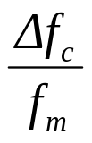
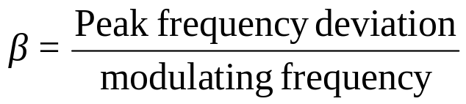
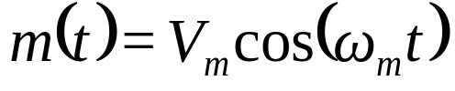
Frequency Modulation
The ratio
is called the Modulation Index denoted by β i.e.
Note – FM, as implicit in the above equation for v_{s}(t), is a non-linear process – i.e.
the principle of superposition does not apply. The FM signal for a message m(t) as a
band of signals is very complex. Hence, m(t) is usually considered as a 'single tone
modulating signal' of the form
5

Slide 6
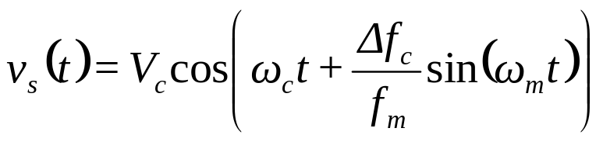
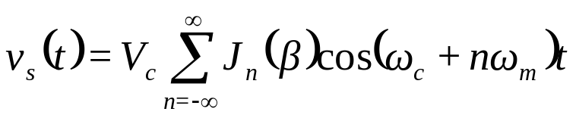
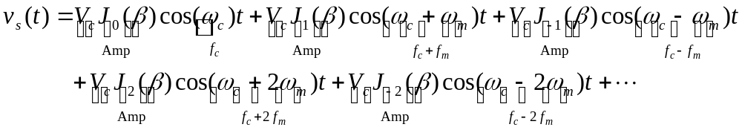
Frequency Modulation
The equation
may be expressed as Bessel
series (Bessel functions)
where J_{n}(β) are Bessel functions of the first kind. Expanding the equation for a few
terms we have:
6

Slide 7
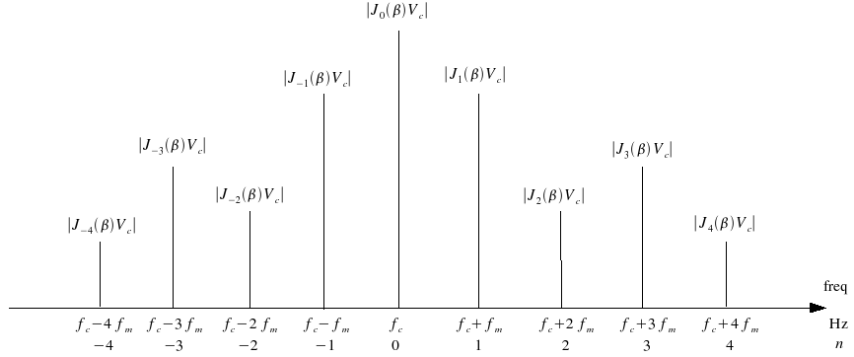
FM Signal Spectrum.
The amplitudes drawn are completely arbitrary, since we have not found any value for
J_{n}(β) – this sketch is only to illustrate the spectrum.
7

Slide 8
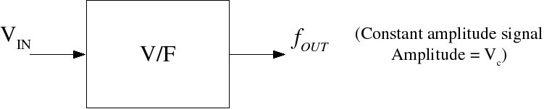
Generation of FM signals – Frequency Modulation.
An FM demodulator is:
  a voltage-to-frequency converter V/F
  a voltage controlled oscillator VCO
In these devices (V/F or VCO), the output frequency is dependent on the input voltage
amplitude.
8

Slide 9
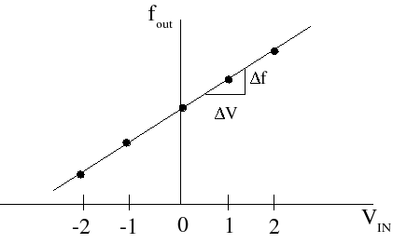
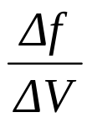
V/F Characteristics.
Apply V_{IN} , e.g. 0 Volts, +1 Volts, +2 Volts, -1 Volts, -2 Volts, ... and measure the
frequency output for each V_{IN} . The ideal V/F characteristic is a straight line as
shown below.
f_{c}, the frequency output when the input is zero is called the undeviated or nominal
carrier frequency.
The gradient of the characteristic
is called the Frequency Conversion Factor,
denoted by α per Volt.
9

Slide 10

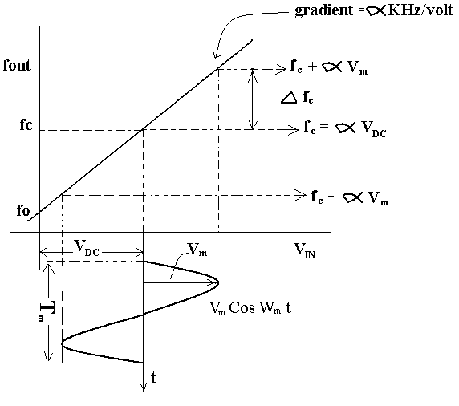
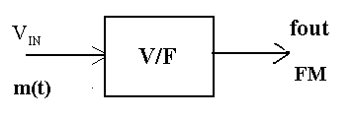

V/F Characteristics.
Consider now, an analogue message input,
As the input m(t) varies from
the output frequency will vary from a
maximum, through f_{c}, to a minimum
frequency.
10

Slide 11


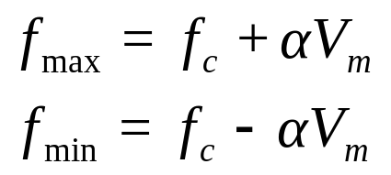

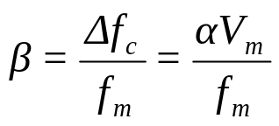
V/F Characteristics.
For a straight line, y = c + mx, where c = value of y when x = 0, m = gradient, hence
we may say
and when V_{IN} = m(t)
,i.e. the deviation depends on m(t).
Considering that maximum and minimum input amplitudes are +V_{m} and -V_{m}
respectively, then
on the diagram on the previous slide.
The peak-to-peak deviation is f_{max} – f_{min}, but more importantly for FM the peak
deviation Δf_{c} is
Peak Deviation,
Hence, Modulation Index,
11

Slide 12



Summary of the important points of FM
In FM, the message signal m(t) is assumed to be a single tone frequency,
The FM signal v_{s}(t) from which the spectrum may be obtained as
where J_{n}(β) are Bessel coefficients and
Modulation Index,
α Hz per Volt is the V/F modulator, gradient or
Frequency Conversion Factor,
α per Volt
α is a measure of the change in output frequency for a change in input amplitude.
Peak Deviation (of the carrier frequency from f_{c})
12

Slide 13
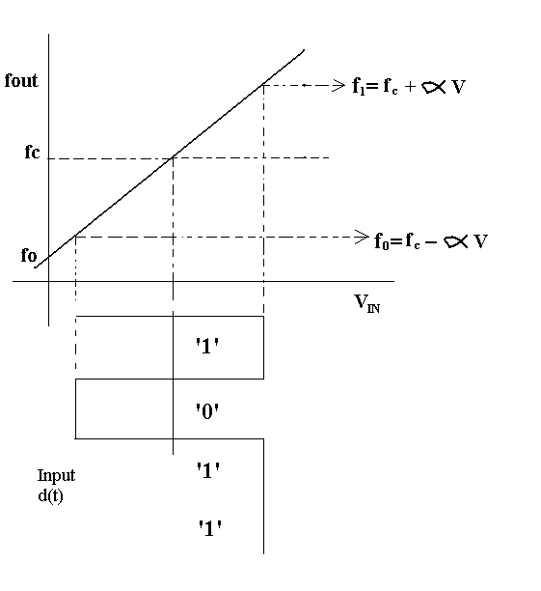
FM Signal Waveforms.
The diagrams below illustrate FM signal waveforms for various inputs
At this stage, an input digital data
sequence, d(t), is introduced –
the output in this case will be FSK,
(Frequency Shift Keying).
13

Slide 14
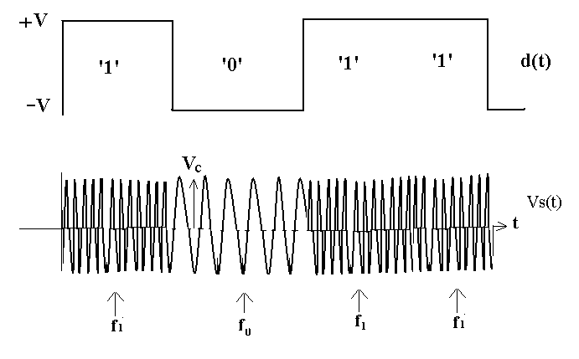
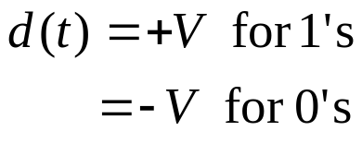
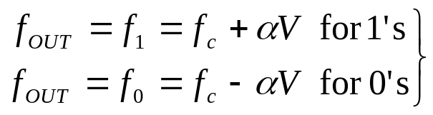
FM Signal Waveforms.
Assuming
the output ‘switches’
between f₁ and f₀.
14

Slide 15
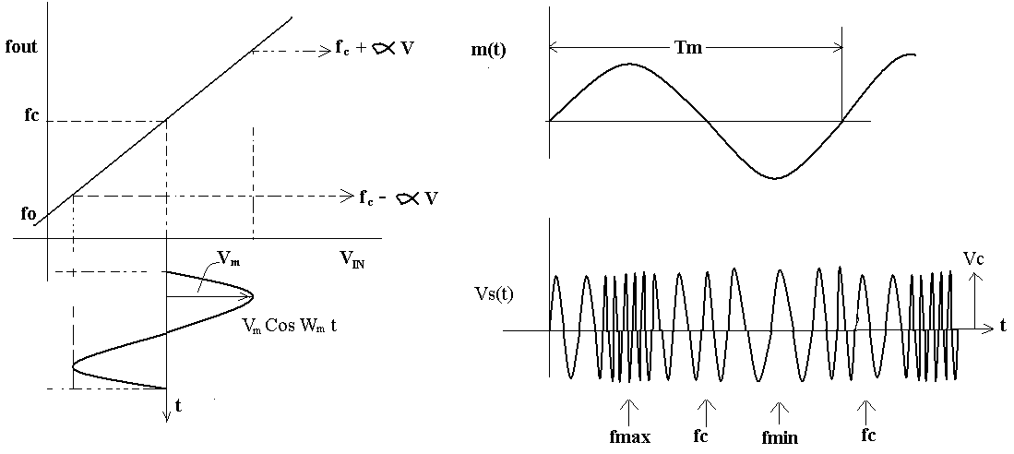
FM Signal Waveforms.
The output frequency varies ‘gradually’ from f_{c} to (f_{c} + αV_{m}), through f_{c} to
(f_{c} - αV_{m}) etc.
15

Slide 16
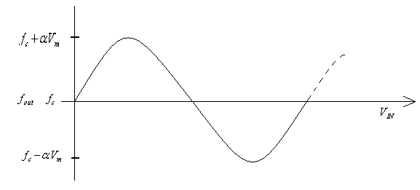
FM Signal Waveforms.
If we plot f_{OUT} as a function of V_{IN}:
In general, m(t) will be a ‘band of signals’, i.e. it will contain amplitude and frequency
variations. Both amplitude and frequency change in m(t) at the input are translated to
(just) frequency changes in the FM output signal, i.e. the amplitude of the output FM
signal is constant.
Amplitude changes at the input are translated to deviation from the carrier at the
output. The larger the amplitude, the greater the deviation.
16

Slide 17
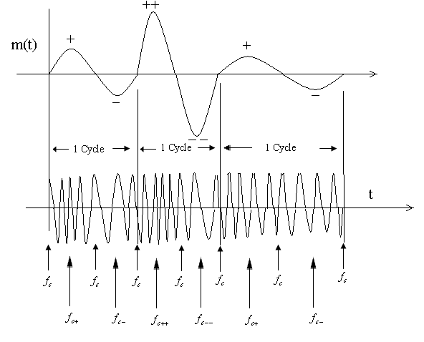
FM Signal Waveforms.
Frequency changes at the input are translated to rate of change of frequency at the
output.
An attempt to illustrate this is shown below:
17

Slide 18
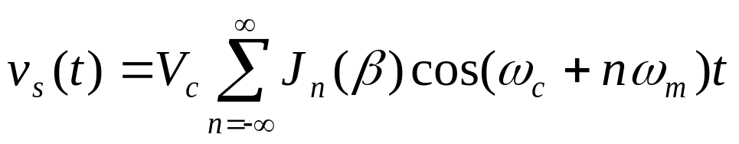
FM Spectrum – Bessel Coefficients.
The FM signal spectrum may be determined from
The values for the Bessel coefficients, J_{n}(β) may be found from
graphs or, preferably, tables of ‘Bessel functions of the first kind’.
18

Slide 19
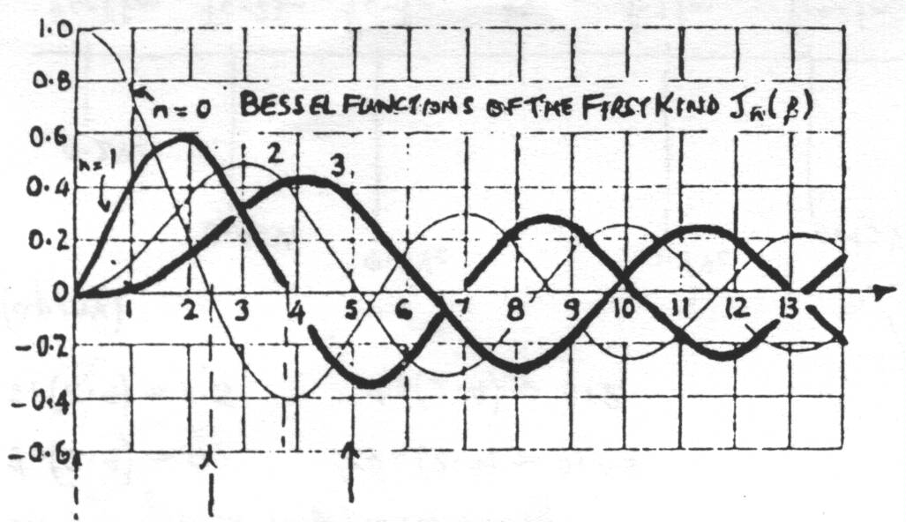

FM Spectrum – Bessel Coefficients.
J_{n}(β)
β
β = 2.4
β = 5
In the series for v_{s}(t), n = 0 is the carrier component, i.e.
, hence the
n = 0 curve shows how the component at the carrier frequency, f_{c}, varies in amplitude,
with modulation index β.
19

Slide 20
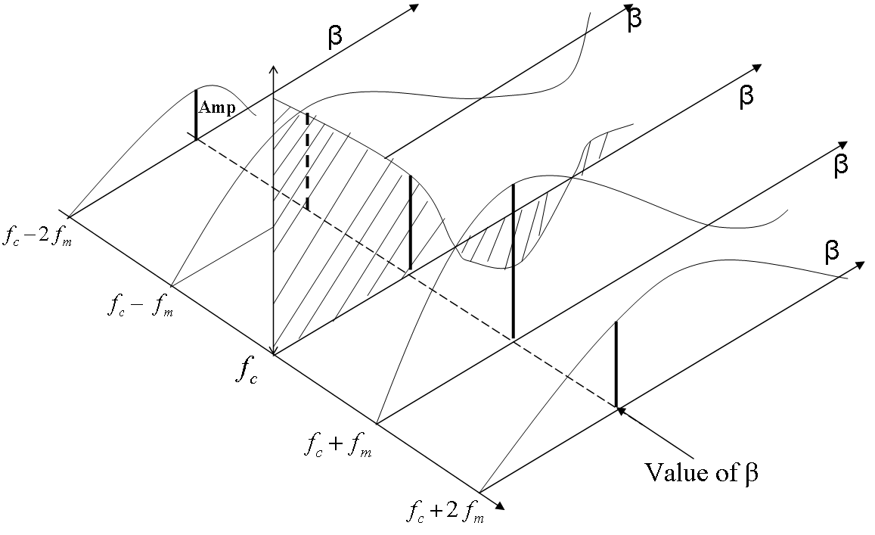
FM Spectrum – Bessel Coefficients.
Hence for a given value of modulation index β, the values of J_{n}(β) may be read off the
graph and hence the component amplitudes (V_{c}J_{n}(β)) may be determined.
A further way to interpret these curves is to imagine them in 3 dimensions
20

Slide 21
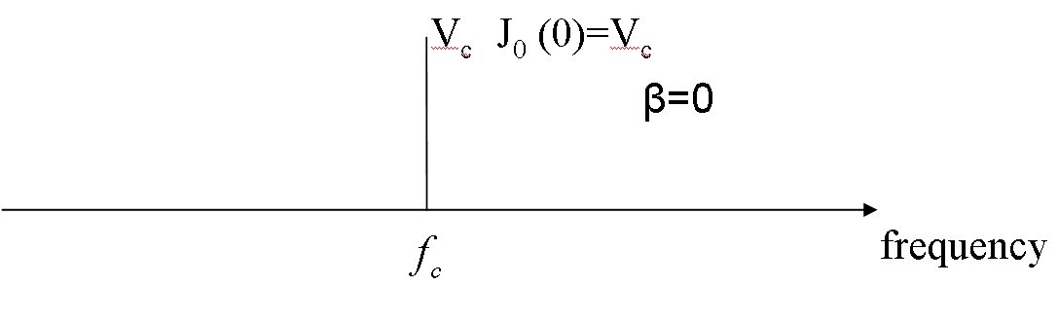
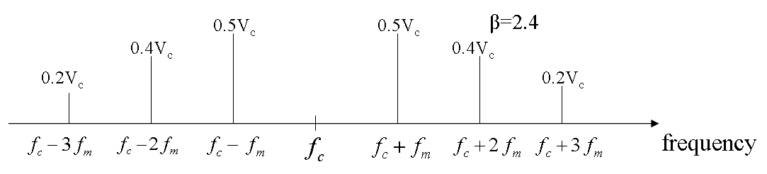
Examples from the graph
β = 0: When β = 0 the carrier is unmodulated and J₀(0) = 1, all other J_{n}(0) = 0, i.e.
β = 2.4: From the graph (approximately)
J₀(2.4) = 0, J₁(2.4) = 0.5, J₂(2.4) = 0.45 and J₃(2.4) = 0.2
21

Slide 22
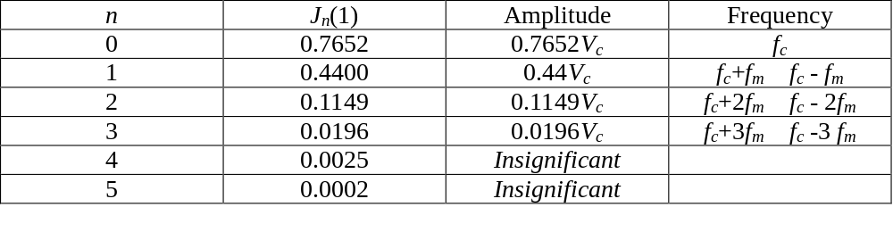
Significant Sidebands – Spectrum.
As may be seen from the table of Bessel functions, for values of n above a certain
value, the values of J_{n}(β) become progressively smaller. In FM the sidebands are
considered to be significant if J_{n}(β) ≥ 0.01 (1%).
Although the bandwidth of an FM signal is infinite, components with amplitudes
V_{c}J_{n}(β), for which J_{n}(β) < 0.01 are deemed to be insignificant and may be ignored.
Example: A message signal with a frequency f_{m} Hz modulates a carrier f_{c} to produce
FM with a modulation index β = 1. Sketch the spectrum.
22

Slide 23
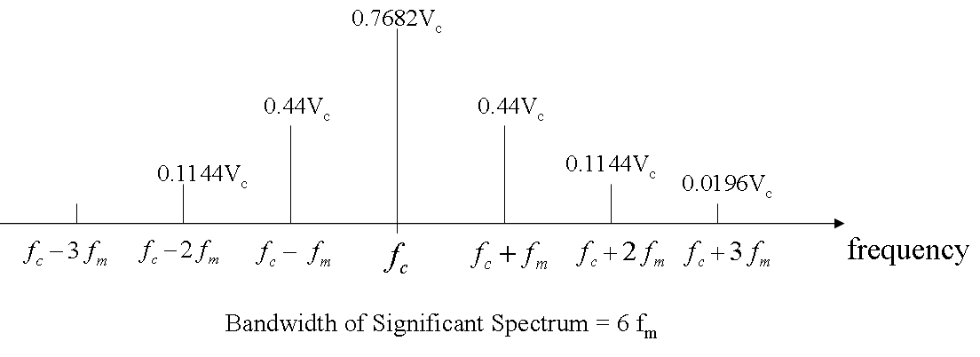
Significant Sidebands – Spectrum.
As shown, the bandwidth of the spectrum containing significant
components is 6f_{m}, for β = 1.
23

Slide 24
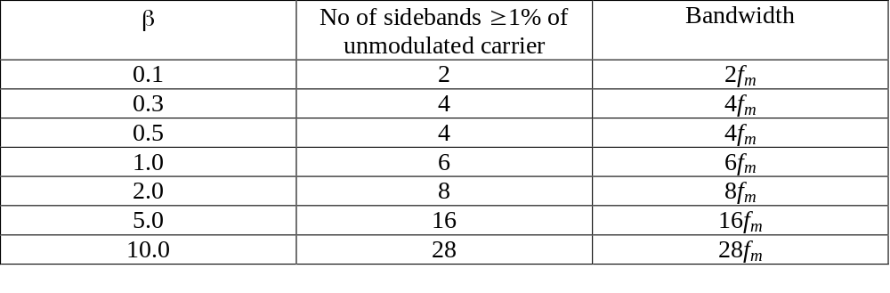
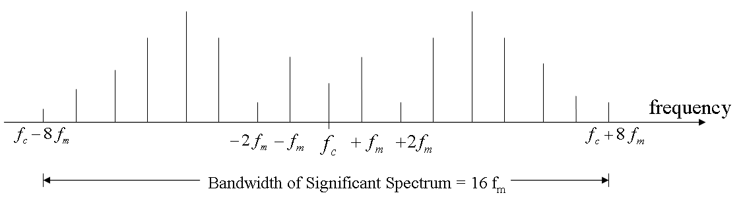
Significant Sidebands – Spectrum.
The table below shows the number of significant sidebands for various modulation
indices (β) and the associated spectral bandwidth.
e.g. for β = 5,
16 sidebands
(8 pairs).
24

Slide 25
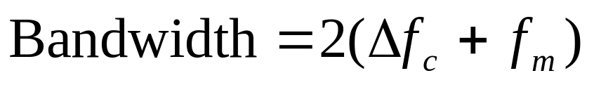
Carson’s Rule for FM Bandwidth.
An approximation for the bandwidth of an FM signal is given by
BW = 2(Maximum frequency deviation + highest modulated
frequency)
Carson’s Rule
25

Slide 26
Narrowband and Wideband FM
Narrowband FM NBFM
From the graph/table of Bessel functions it may be seen that for small β, (β ≤ 0.3)
there is only the carrier and 2 significant sidebands, i.e. BW = 2fm.
FM with β ≤ 0.3 is referred to as narrowband FM (NBFM) (Note, the bandwidth is
the same as DSBAM).
Wideband FM WBFM
For β > 0.3 there are more than 2 significant sidebands. As β increases the number of
sidebands increases. This is referred to as wideband FM (WBFM).
26

Slide 27

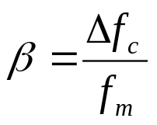
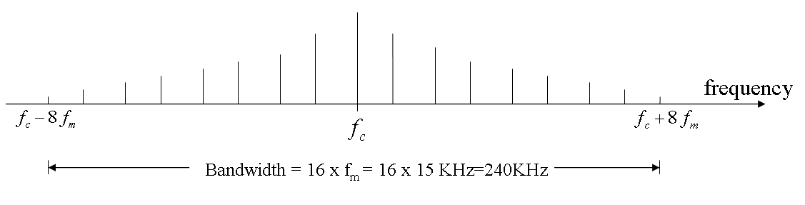
VHF/FM
VHF/FM (Very High Frequency band = 30MHz – 300MHz) radio transmissions, in the
band 88MHz to 108MHz have the following parameters:
Max frequency input (e.g. music) 15kHz
f_{m}
Deviation 75kHz
Modulation Index β 5
For β = 5 there are 16 sidebands and the FM signal bandwidth is 16fm = 16 x 15kHz
= 240kHz.
Applying Carson’s Rule BW = 2(75+15) = 180kHz.
27

Slide 28
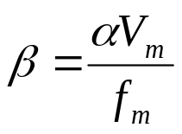
Comments FM
The FM spectrum contains a carrier component and an infinite number of sidebands
at frequencies f_{c} ± nf_{m} (n = 0, 1, 2, …)
FM signal,
In FM we refer to sideband pairs not upper and lower sidebands. Carrier or other
components may not be suppressed in FM.
The relative amplitudes of components in FM depend on the values J_{n}(β),
where
thus the component at the carrier frequency depends on m(t), as do all the
other components and none may be suppressed.
28

Slide 29
Comments FM
Components are significant if J_{n}(β) ≥ 0.01. For β<<1 (β ≈ 0.3 or less) only J₀(β) and
J₁(β) are significant, i.e. only a carrier and 2 sidebands. Bandwidth is 2f_{m}, similar to
DSBAM in terms of bandwidth - called NBFM.
Large modulation index
means that a large bandwidth is required – called
WBFM.
The FM process is non-linear. The principle of superposition does not apply. When
m(t) is a band of signals, e.g. speech or music the analysis is very difficult
(impossible?). Calculations usually assume a single tone frequency equal to the
maximum input frequency. E.g. m(t) ≡ band 20Hz → 15kHz, fm = 15kHz is used.
29

Slide 30
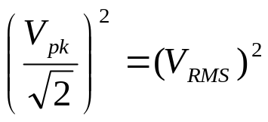
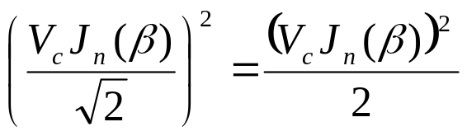
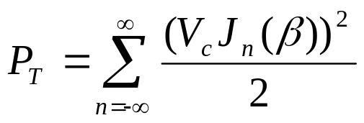
Power in FM Signals.
From the equation for FM
we see that the peak value of the components is V_{c}J_{n}(β) for the n^{th} component.
Single normalised average power =
then the n^{th} component is
Hence, the total power in the infinite spectrum is
Total power
30

Slide 31
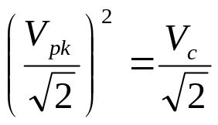
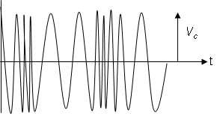
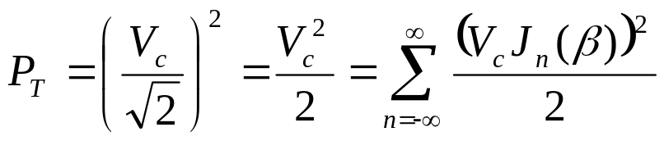
Power in FM Signals.
By this method we would need to carry out an infinite number of calculations to find
P_{T}. But, considering the waveform, the peak value is V_{­c}, which is constant.
Since we know that the RMS value of a sine wave is
and power = (V_{RMS})² then we may deduce that
Hence, if we know V_{c} for the FM signal, we can find the total power P_{T} for the infinite
spectrum with a simple calculation.
31

Slide 32

Power in FM Signals.
Now consider – if we generate an FM signal, it will contain an infinite number of
sidebands. However, if we wish to transfer this signal, e.g. over a radio or cable, this
implies that we require an infinite bandwidth channel. Even if there was an infinite
channel bandwidth it would not all be allocated to one user. Only a limited bandwidth
is available for any particular signal. Thus we have to make the signal spectrum fit into
the available channel bandwidth. We can think of the signal spectrum as a ‘train’ and
the channel bandwidth as a tunnel – obviously we make the train slightly less wider
than the tunnel if we can.
32

Slide 33

Power in FM Signals.
However, many signals (e.g. FM, square waves, digital signals) contain an infinite
number of components. If we transfer such a signal via a limited channel bandwidth,
we will lose some of the components and the output signal will be distorted. If we put
an infinitely wide train through a tunnel, the train would come out distorted, the
question is how much distortion can be tolerated?
Generally speaking, spectral components decrease in amplitude as we move away
from the spectrum ‘centre’.
33

Slide 34



Power in FM Signals.
In general distortion may be defined as
With reference to FM the minimum channel bandwidth required would be just wide
enough to pass the spectrum of significant components. For a bandlimited FM
spectrum, let a = the number of sideband pairs, e.g. for β = 5, a = 8 pairs
(16 components). Hence, power in the bandlimited spectrum P_{BL} is
= carrier power + sideband powers.
34

Slide 35




Power in FM Signals.
Since
Distortion
Also, it is easily seen that the ratio
= 1 – Distortion
i.e. proportion p_{f} power in bandlimited spectrum to total power =
35

Slide 36



Example
Consider NBFM, with β = 0.2. Let V_{c} = 10 volts. The total power in the infinite
spectrum
= 50 Watts, i.e.
= 50 Watts.
From the table – the significant components are
i.e. the carrier + 2 sidebands contain
or 99% of the total power
36

Slide 37




Example
Distortion =
or 1%.
Actually, we don’t need to know V_{c}, i.e. alternatively
Distortion =
(a = 1)
D =
Ratio
37

Slide 38

FM Demodulation –General Principles.
An FM demodulator or frequency discriminator is essentially a frequency-to-voltage
converter (F/V). An F/V converter may be realised in several ways, including for
example, tuned circuits and envelope detectors, phase locked loops etc.
Demodulators are also called FM discriminators.
Before considering some specific types, the general concepts for FM demodulation
will be presented. An F/V converter produces an output voltage, V_{OUT} which is
proportional to the frequency input, f_{IN}.
38

Slide 39

FM Demodulation –General Principles.
If the input is FM, the output is m(t), the analogue message signal. If the input is FSK,
the output is d(t), the digital data sequence.
In this case f_{IN} is the independent variable and V_{OUT} is the dependent variable (x and
y axes respectively). The ideal characteristic is shown below.
We define V_{o} as the output when f_{IN} = f_{c}, the nominal input frequency.
39

Slide 40


FM Demodulation –General Principles.
The gradient
is called the voltage conversion factor
i.e. Gradient = Voltage Conversion Factor, K volts per Hz.
Considering y = mx + c etc. then we may say V_{OUT} = V₀ + Kf_{IN} from the frequency
modulator, and since V₀ = V_{OUT} when f_{IN} = f_{c} then we may write
where V₀ represents a DC offset in V_{OUT}. This DC offset may be removed by level
shifting or AC coupling, or the F/V may be designed with the characteristic shown next
40

Slide 41

FM Demodulation –General Principles.
The important point is that V_{OUT} = KαV_{IN}. If V_{IN} = m(t) then the output contains the
message signal m(t), and the FM signal has been demodulated.
41

Slide 42


FM Demodulation –General Principles.
Often, but not always, a system designed so that
, so that Kα = 1 and
V_{OUT} = m(t).
A complete system is illustrated.
42

Slide 43

FM Demodulation –General Principles.
43

Slide 44

Methods
Tuned Circuit – One method (used in the early days of FM) is to use the slope of a
tuned circuit in conjunction with an envelope detector.
44

Slide 45
Methods
The tuned circuit is tuned so the f_{c}, the nominal input frequency, is on the slope, not at
the centre of the tuned circuits. As the FM signal deviates about f_{c} on the tuned circuit
slope, the amplitude of the output varies in proportion to the deviation from f_{c}. Thus
the FM signal is effectively converted to AM. This is then envelope detected by the
diode etc to recover the message signal.
Note: In the early days, most radio links were AM (DSBAM). When FM came along,
with its advantages, the links could not be changed to FM quickly. Hence, NBFM was
used (with a spectral bandwidth = 2fm, i.e. the same as DSBAM). The carrier
frequency fc was chosen and the IF filters were tuned so that fc fell on the slope of the
filter response. Most FM links now are wideband with much better demodulators.
A better method is to use 2 similar circuits, known as a Foster-Seeley Discriminator
45

Slide 46

Foster-Seeley Discriminator
This gives the composite characteristics shown. Diode D₂ effectively inverts the f₂
tuned circuit response. This gives the characteristic ‘S’ type detector.
46

Slide 47

Phase Locked Loops PLL
A PLL is a closed loop system which may be used for FM demodulation. A full
analytical description is outside the scope of these notes. A brief description is
presented. A block diagram for a PLL is shown below.
Note the similarity with a synchronous demodulator. The loop comprises a multiplier,
a low pass filter and VCO (V/F converter as used in a frequency modulator).
47

Slide 48
Phase Locked Loops PLL
The input f_{IN} is applied to the multiplier and multiplied with the VCO frequency output f_{O}, to produce Σ = (f_{IN} + f_{O}) and Δ = (f_{IN} – f_{O}).
The low pass filter passes only (f_{IN} – f_{O}) to give VOUT which is proportional to (f_{IN} – f_{O}).
If f_{IN} ≈ f_{O} but not equal, V_{OUT} = V_{IN}, αf_{IN} – f_{O} is a low frequency (beat frequency) signal to the VCO.
This signal, V_{IN}, causes the VCO output frequency f_{O} to vary and move towards f_{IN}.
When f_{IN} = f_{O}, V_{IN} (f_{IN} – f_{O}) is approximately constant (DC) and f_{O} is held constant, i.e locked to f_{IN}.
As f_{IN} changes, due to deviation in FM, f_{O} tracks or follows f_{IN}. V_{OUT} = V_{IN} changes to drive f_{O} to track f_{IN}.
V_{OUT} is therefore proportional to the deviation and contains the message signal m(t).
48

